Slide 1
Deep Generative Models
Mostafa Tavassolipour
Fall 2024

Slide 2
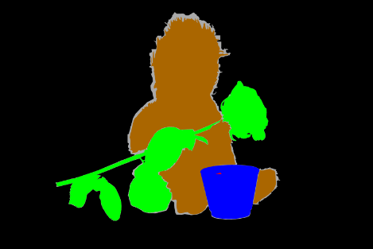
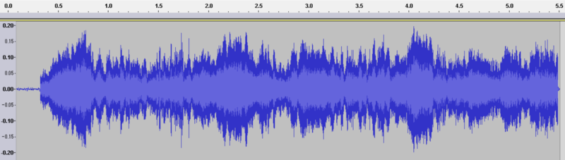
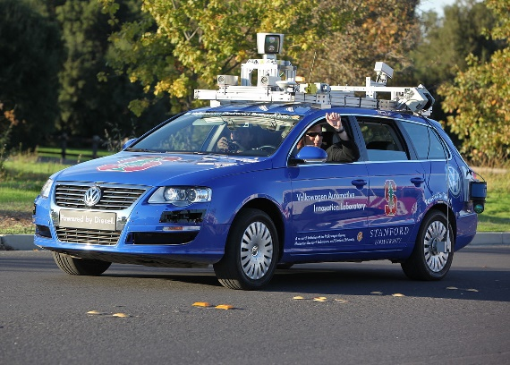
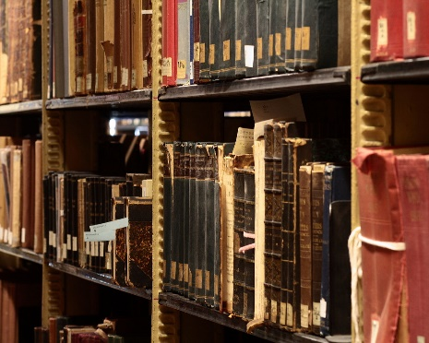
Introduction
Challenge: understand complex, unstructured inputs
Computer Vision
Computational Speech
Natural Language Processing
Robotics
Notes:
Problem: making sense of complex, unstructured sensory inputs. Images, speech, text, video, etc.
https://commons.wikimedia.org/wiki/Language#/media/File:Floor_7a_bookstacks_in_Sterling_Memorial_Library.jpg
https://commons.wikimedia.org/wiki/File:EmiMa-099-semantic-segmentation.png
https://commons.wikimedia.org/wiki/File:Waveform_of_Habana_syndrome_sound.png
https://commons.wikimedia.org/w/index.php?title=Special:Search&limit=500&offset=0&ns0=1&ns6=1&ns12=1&ns14=1&ns100=1&ns106=1&search=Autonomous+cars&advancedSearch-current={}

Slide 3

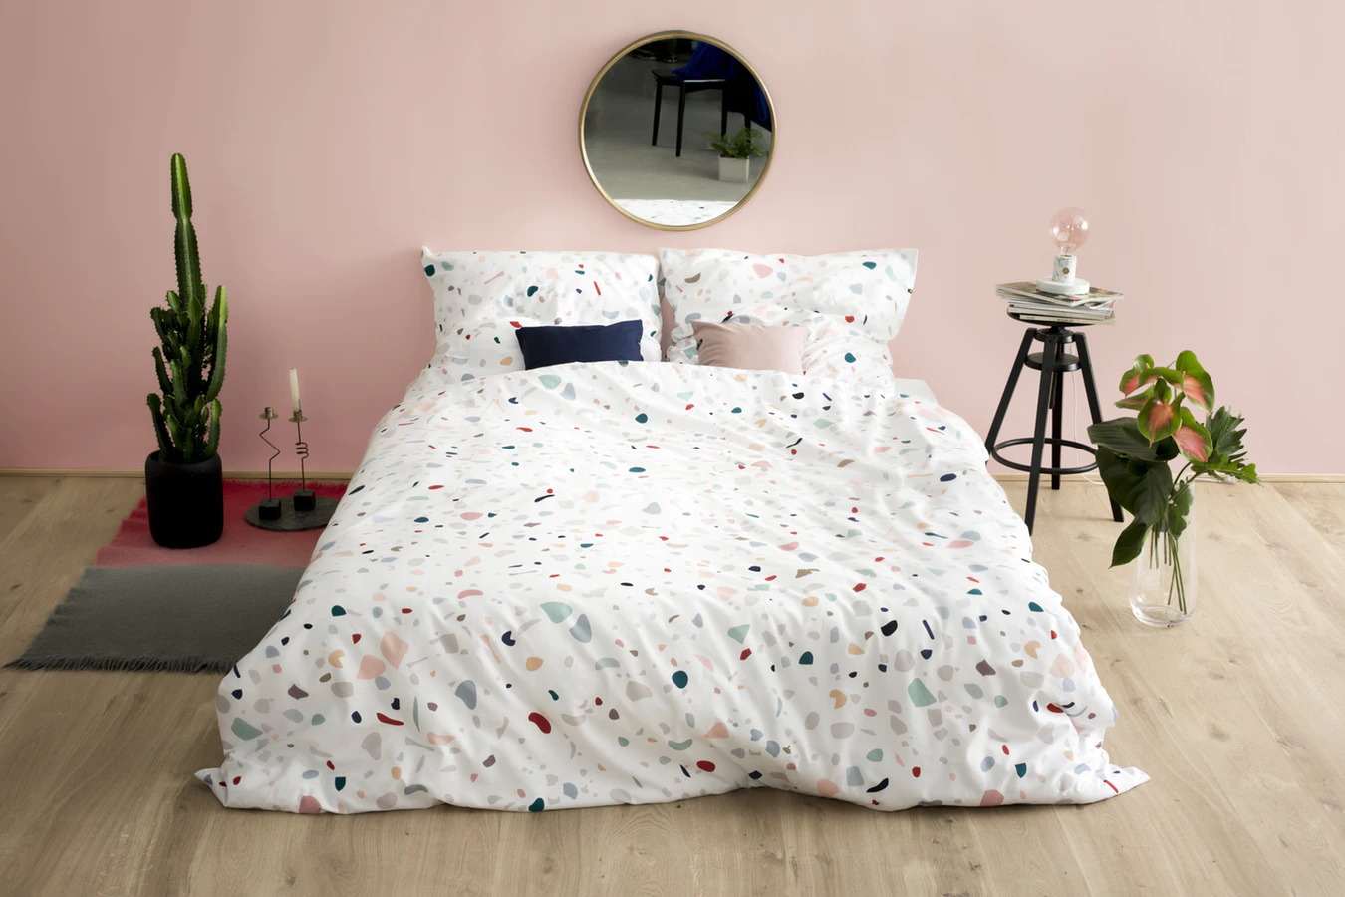



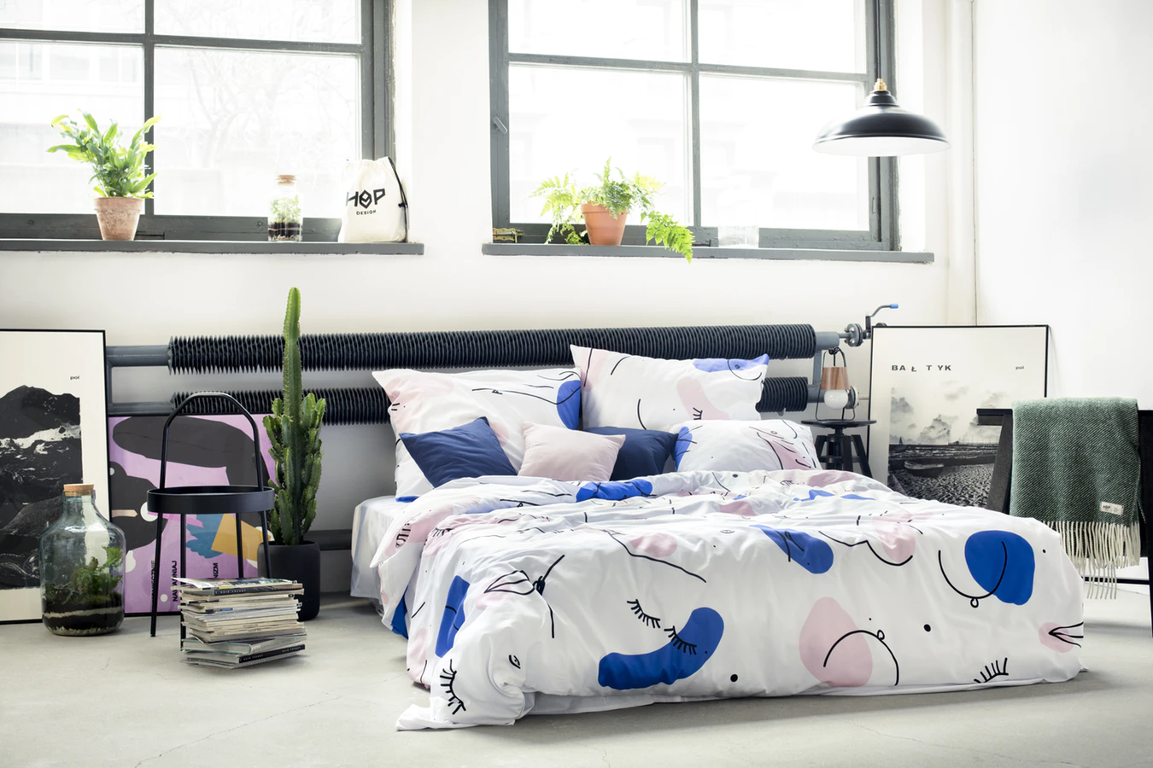
Statistical Generative Models
Statistical generative models are learned from data
Priors are always necessary, but there is a spectrum
+
…
Data
(e.g., images of bedrooms)
Prior Knowledge
(e.g., physics, materials, ..)
This course
Graphics
Prior Knowledge
Data
Notes:
We are concerned with statistical generative models
Graphics: purely based on prior knowledge. Difficult to scale. Developing the field took a very long time. Still not entirely solved, active area of research.
Motivation: Reduce the amount of prior knowledge and use data. (machine learning)
Note: cannot do something purely based on data. Known impossibility results. Even in discrete spaces, scaling of sample complexity would be doubly-exponential.
https://www.iconfinder.com/icons/1562699/book_energy_idea_knowledge_icon
https://www.yf.io/p/lsun

Slide 4
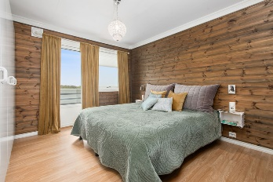


Statistical Generative Models
A statistical generative model is a probability distribution p(x)
Data: samples (e.g., images of bedrooms)
Prior knowledge: parametric form (e.g., Gaussian?), loss function (e.g., maximum likelihood?), optimization algorithm, etc.
It is generative because sampling from p(x) generates new images
A probability distribution
p(x)
Image x
scalar probability p(x)
…
Notes:
We are concerned with statistical generative models
Graphics: purely based on prior knowledge. Difficult to scale. Developing the field took a very long time. Still not entirely solved, active area of research.
Motivation: Reduce the amount of prior knowledge and use data. (machine learning)
Note: cannot do something purely based on data. Known impossibility results. Even in discrete spaces, scaling of sample complexity would be doubly-exponential.

Slide 5
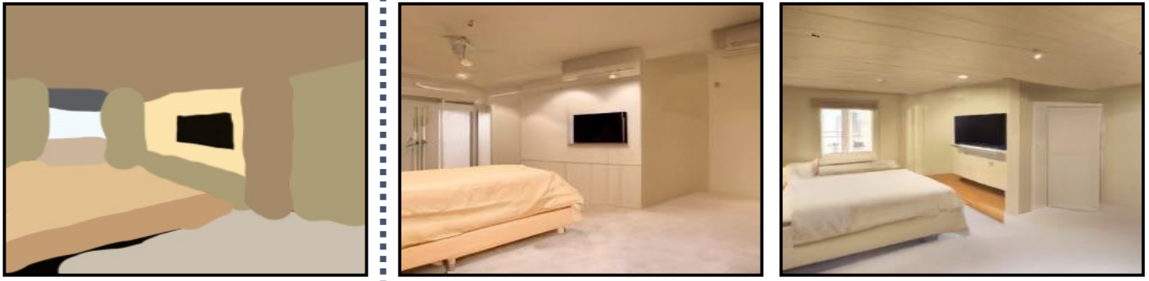
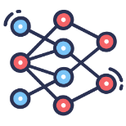
Data generation in the real world
Generate
Generative model of realistic images
Stroke paintings to realistic images
[Meng, He, Song, et al., ICLR 2022]

Slide 6
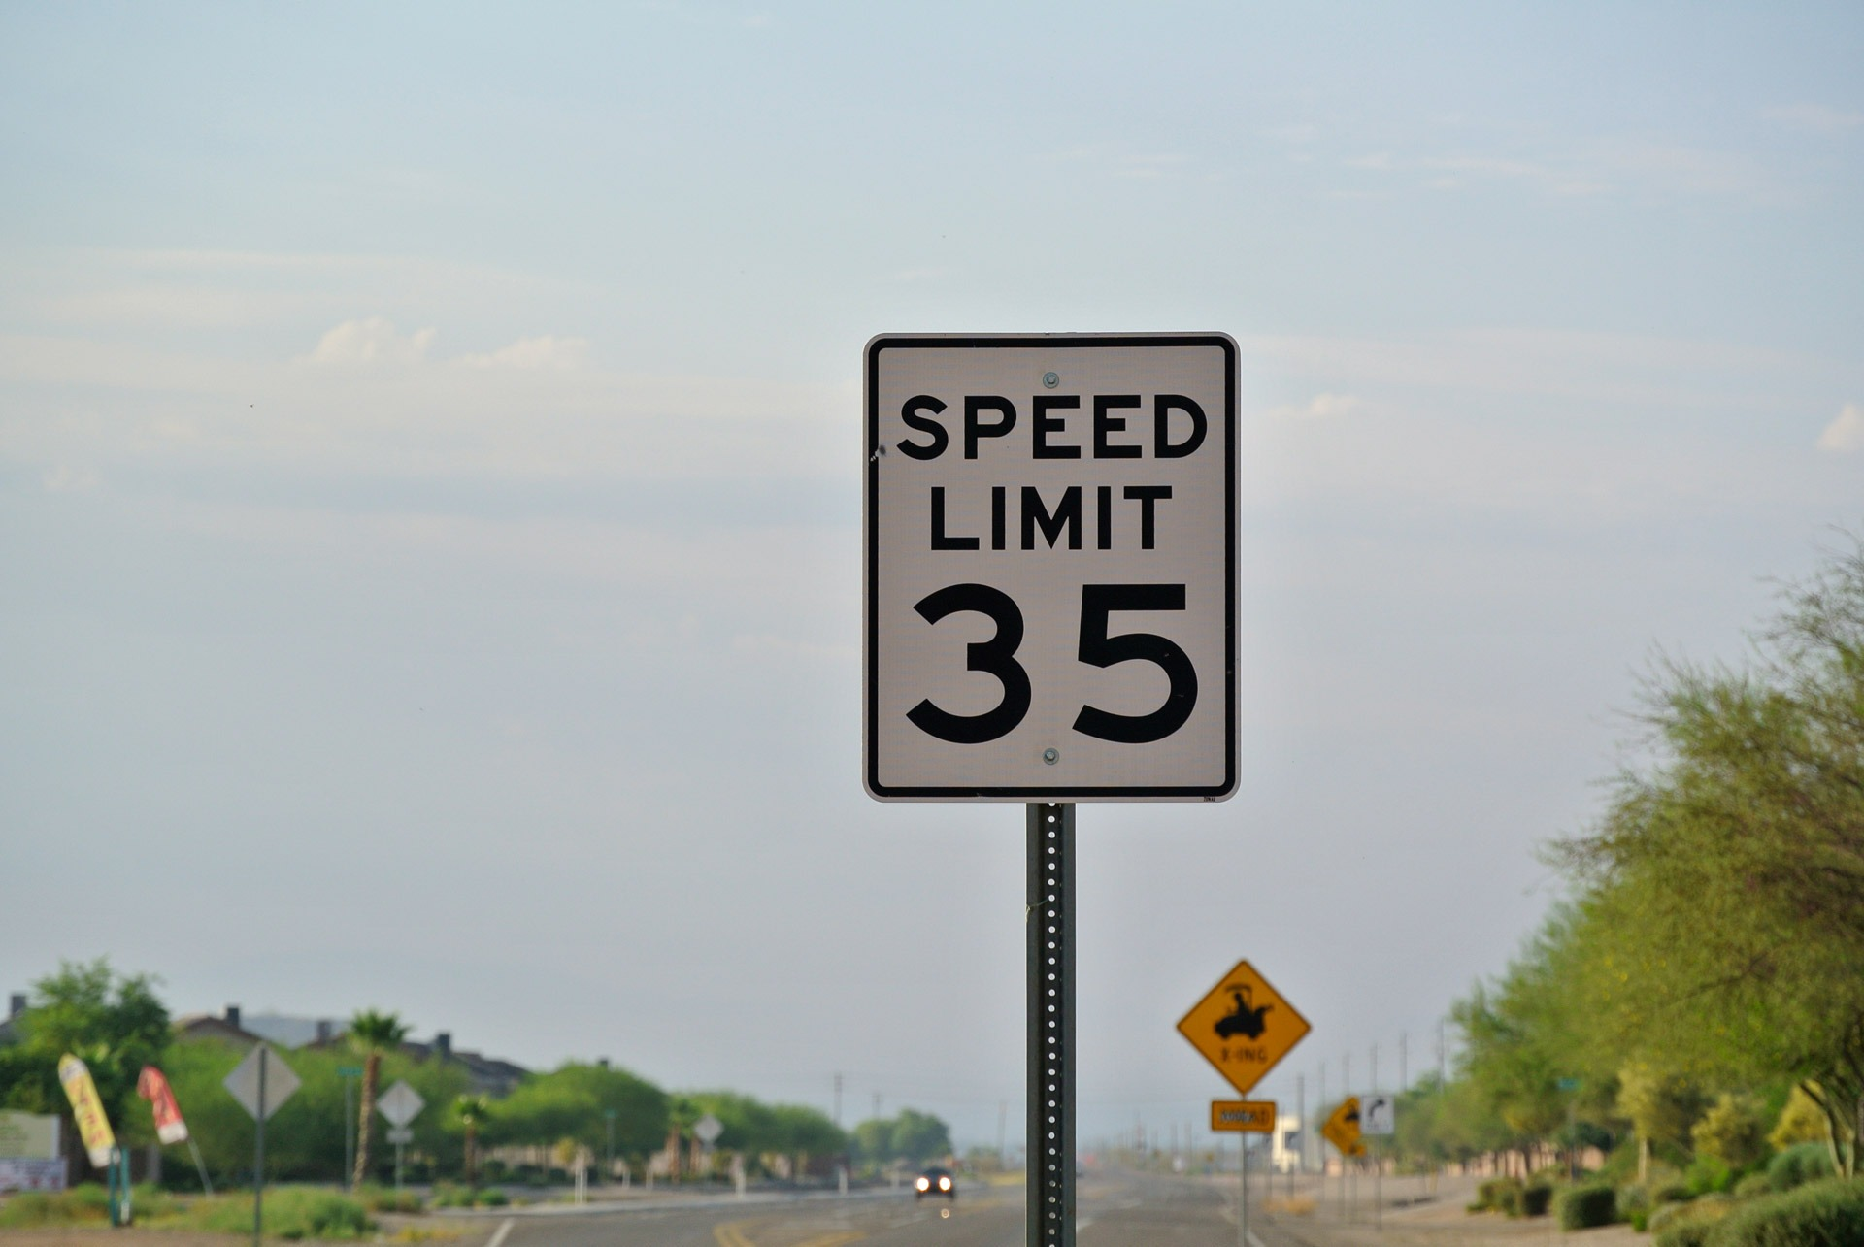
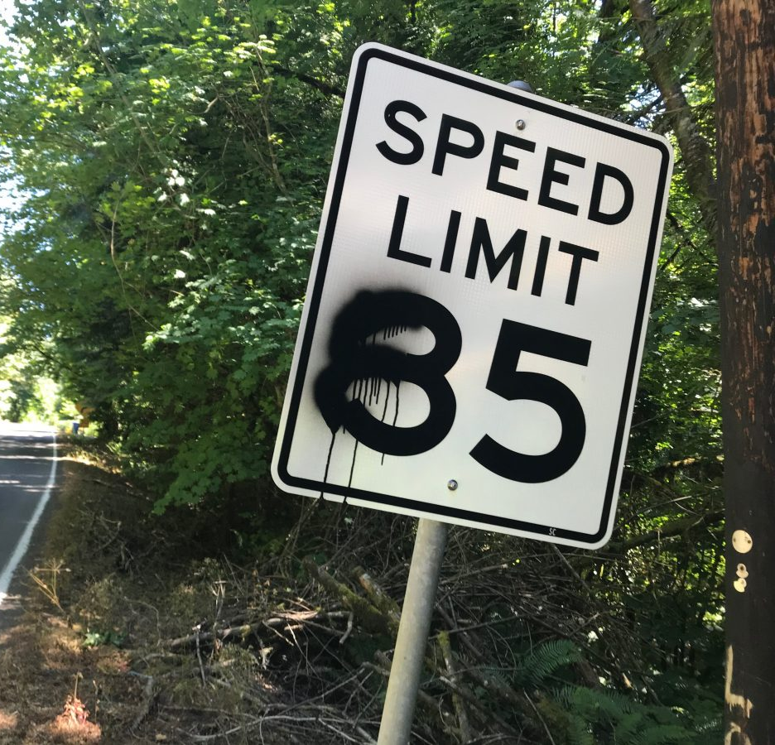

Outlier detection with generative models
High probability
Low probability
Generative model of traffic signs
Outlier detection
[Song et al., ICLR 2018]

Slide 7
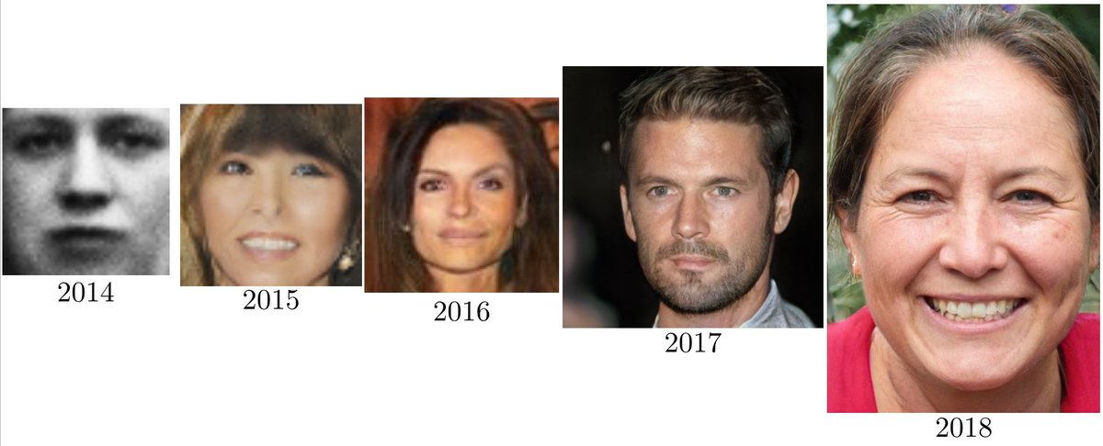
Progress in Generative Models of Images -- GANs
Ian Goodfellow, 2019
Notes:
https://www.youtube.com/watch?v=XOxxPcy5Gr4

Slide 8
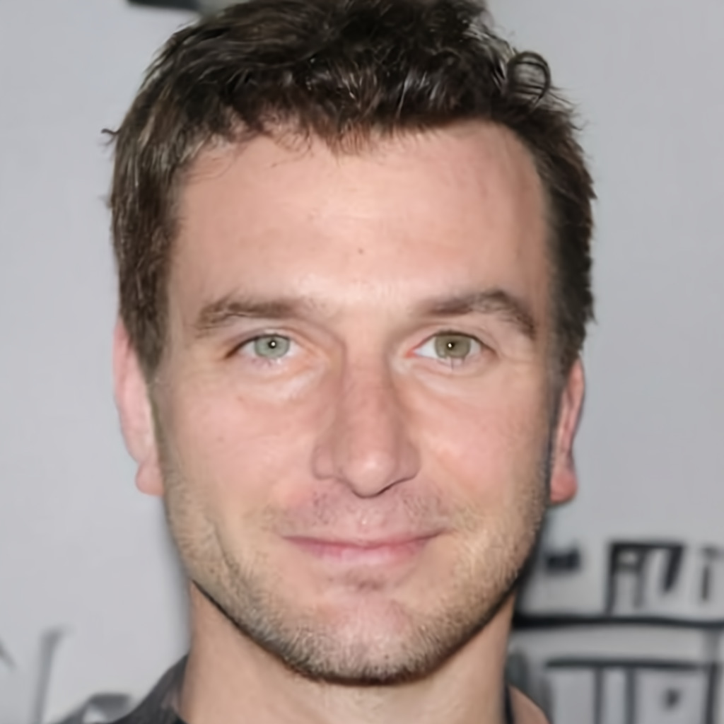
Progress in Generative Models of Images – Diffusion Models
Song et al., Score-Based Generative Modeling through Stochastic Differential Equations, 2021
Notes:
https://www.youtube.com/watch?v=XOxxPcy5Gr4

Slide 9
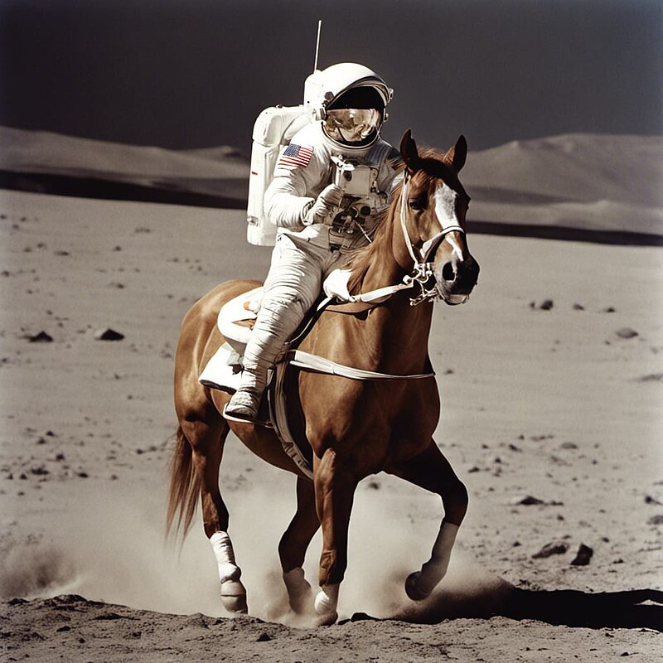
Text2Image Diffusion Models
User input:
An astronaut riding a horse
Notes:
https://www.youtube.com/watch?v=XOxxPcy5Gr4

Slide 10
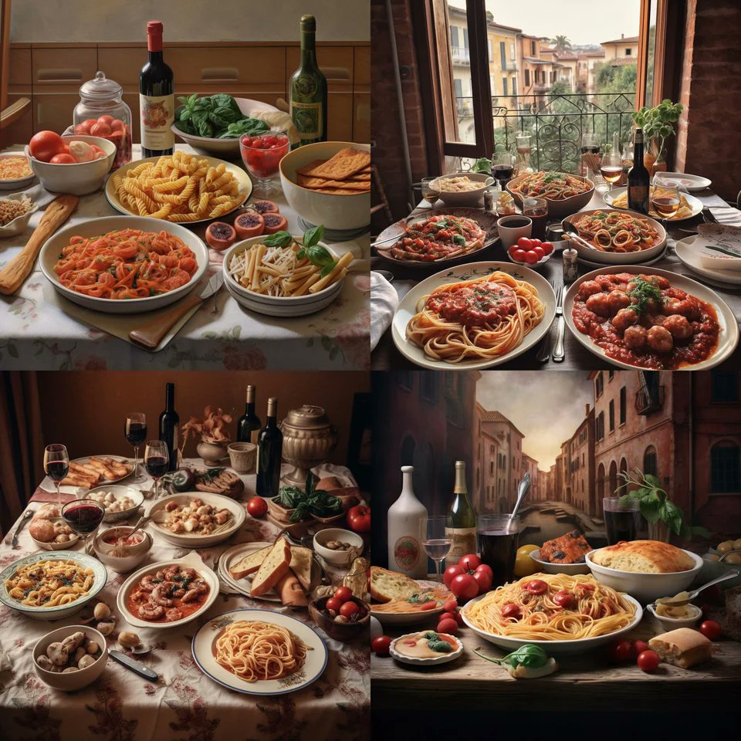
Text2Image Diffusion Models
User input:
A perfect Italian meal
Notes:
https://www.youtube.com/watch?v=XOxxPcy5Gr4

Slide 11
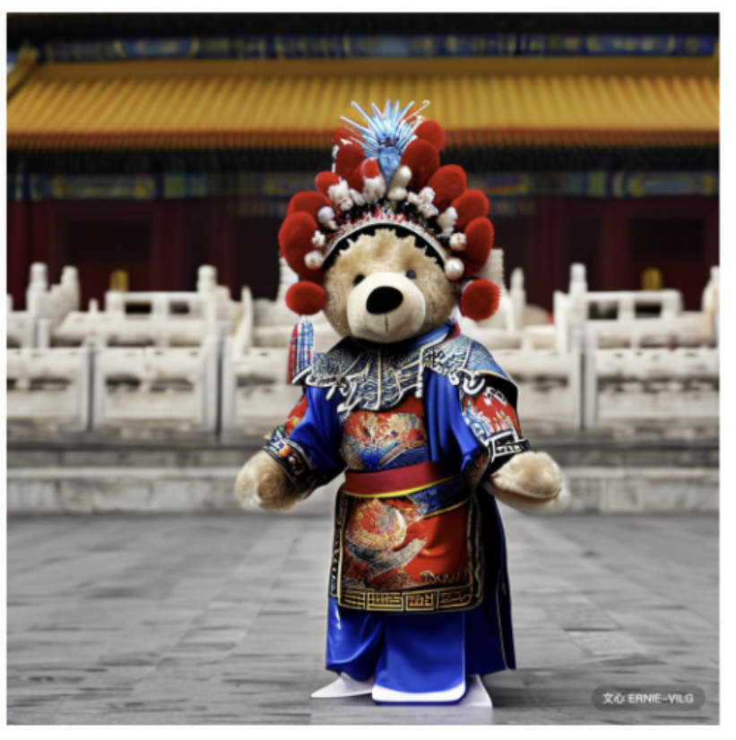
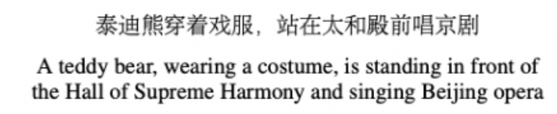
Text2Image Diffusion Models
User input:
Notes:
https://www.youtube.com/watch?v=XOxxPcy5Gr4

Slide 12

Dalle3
A minimap diorama of a cafe adorned with indoor plants. Wooden beams crisscross above, and a cold brew station stands out with tiny bottles and glasses

Slide 13
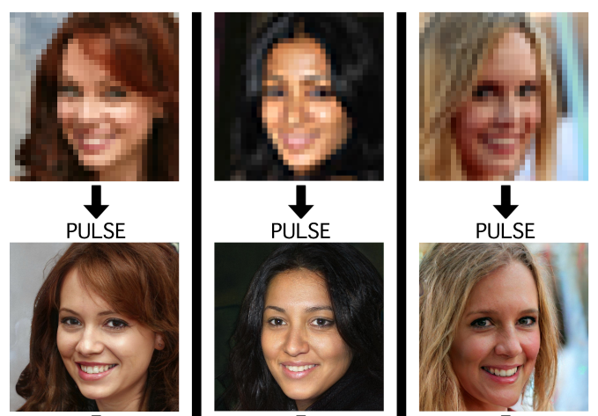
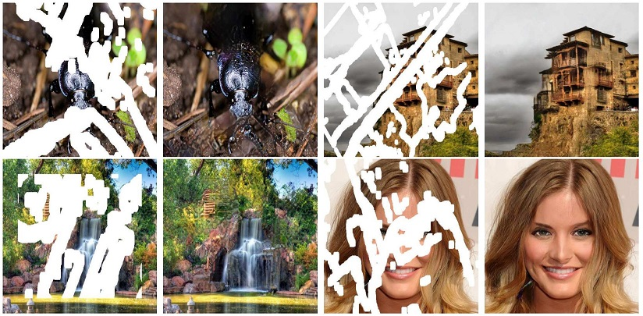
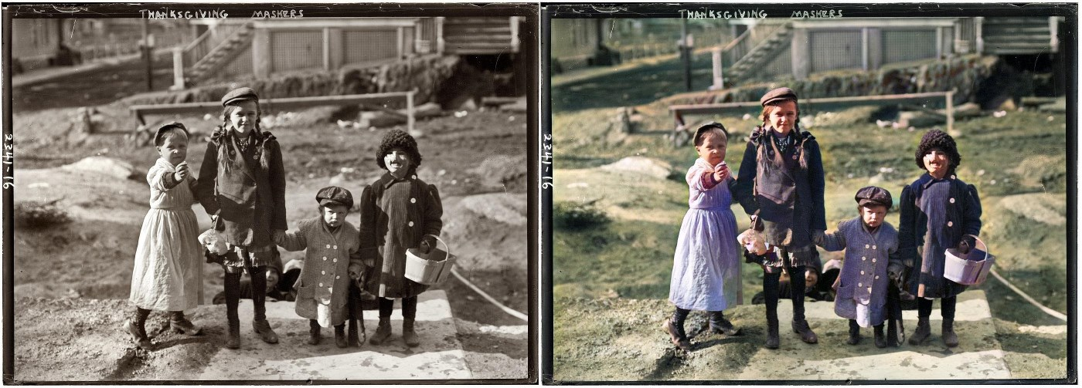
Progress in Inverse Problems
P(high resolution | low resolution)
P(full image| mask)
Menon et al, 2020
Liu al, 2018
P(color image| greyscale)
Antic, 2020
Notes:
In the last few years, we’ve seen a lot of progress in learning generative models of complex objects like images, text, music, videos, molecules. For example, here you can see some amazingly realistic images you can generate using generative adversarial networks.

Slide 14
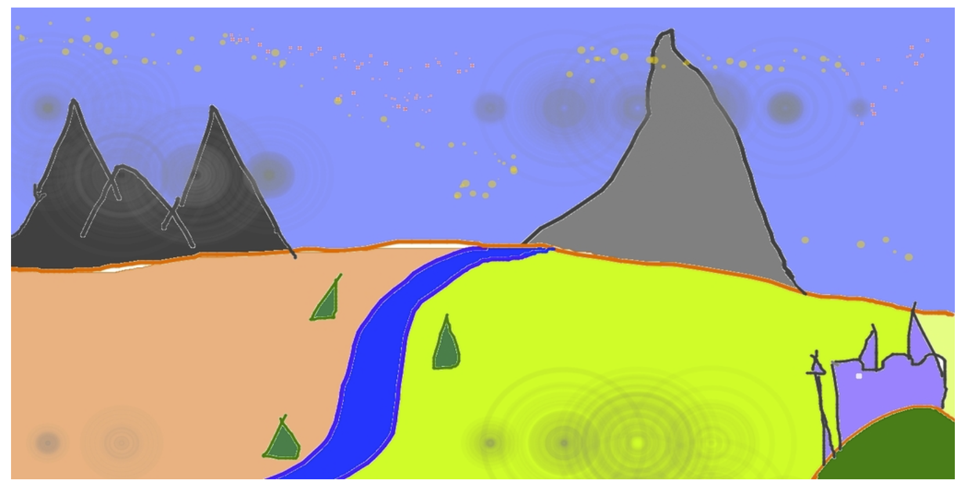
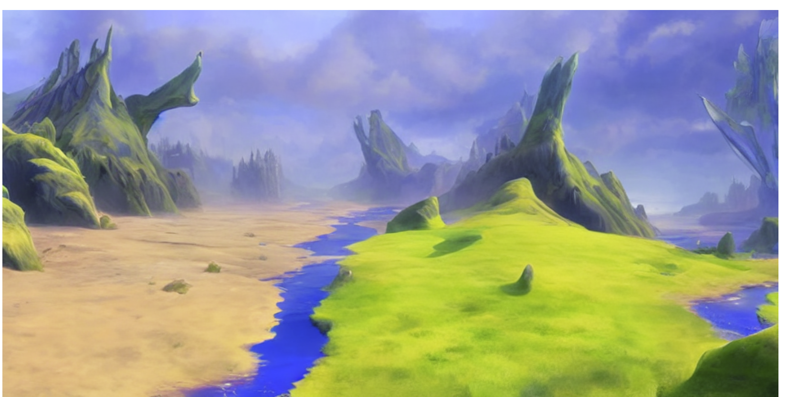
Progress in Inverse Problems
User input:
Notes:
In the last few years, we’ve seen a lot of progress in learning generative models of complex objects like images, text, music, videos, molecules. For example, here you can see some amazingly realistic images you can generate using generative adversarial networks.

Slide 15
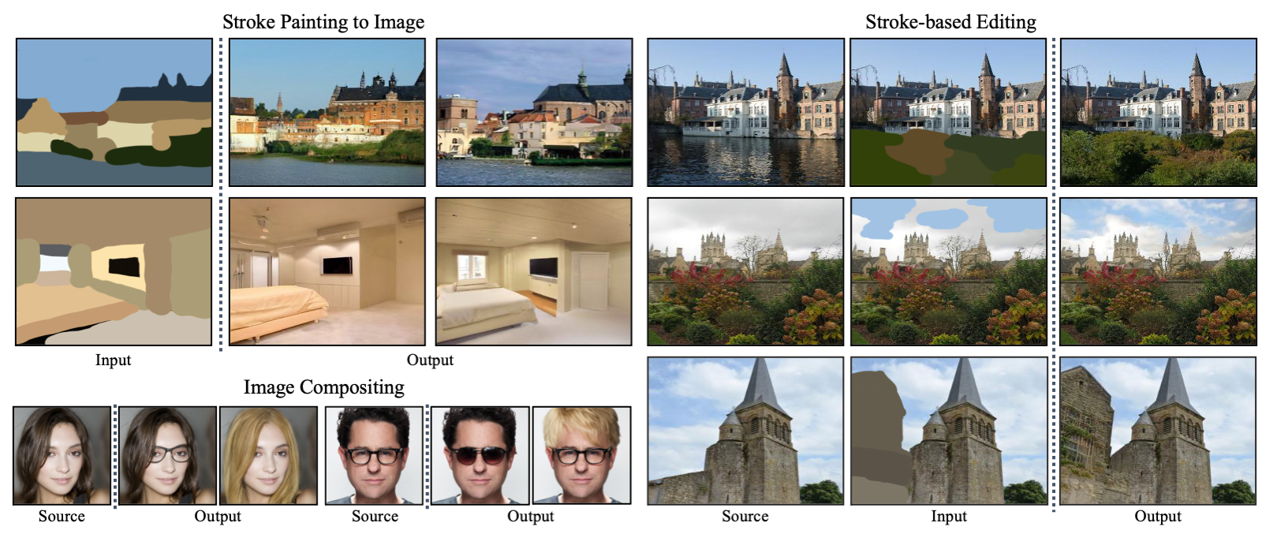
Progress in Inverse Problems
Notes:
In the last few years, we’ve seen a lot of progress in learning generative models of complex objects like images, text, music, videos, molecules. For example, here you can see some amazingly realistic images you can generate using generative adversarial networks.

Slide 16
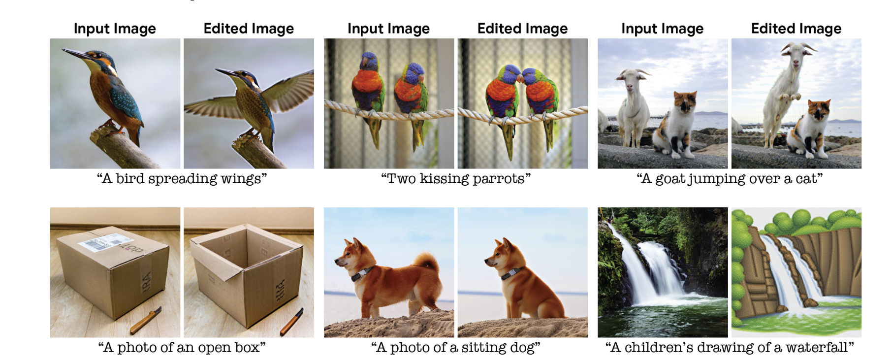
Progress in Inverse Problems
Kawar et al., 2023
Notes:
In the last few years, we’ve seen a lot of progress in learning generative models of complex objects like images, text, music, videos, molecules. For example, here you can see some amazingly realistic images you can generate using generative adversarial networks.

Slide 17
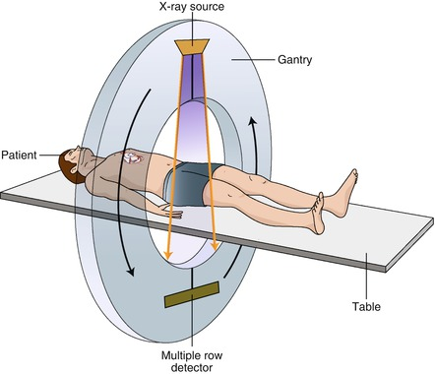
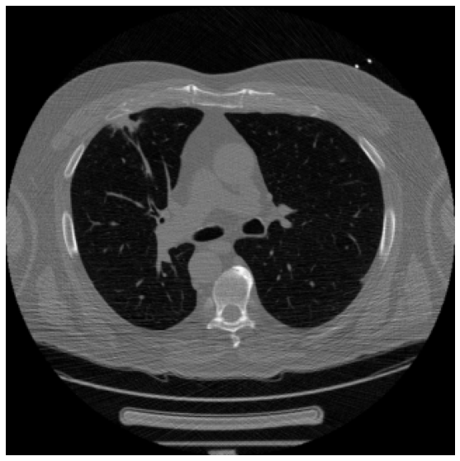

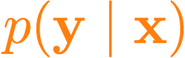
Medical image reconstruction
Cross-sectional image
Sparse-view computed tomography (CT)
Sparse-view sinogram
Forward model is given by physical simulation

Slide 18


WaveNet
Text to Speech
Generative model of speech signals
Parametric
Concatenative
WaveNet
Unconditional
Music
van den Oord et al, 2016c
Notes:
https://deepmind.com/blog/wavenet-generative-model-raw-audio/

Slide 19
Diffusion Text2Speech
Generative model of speech signals
Betker, Better speech synthesis through scaling 2023
Notes:
https://deepmind.com/blog/wavenet-generative-model-raw-audio/

Slide 20
Audio Super Resolution
Conditional generative model P(high-res signal | low-res audio signal)
Low res signal
High res audio signal
Kuleshov et al., 2017

Slide 21
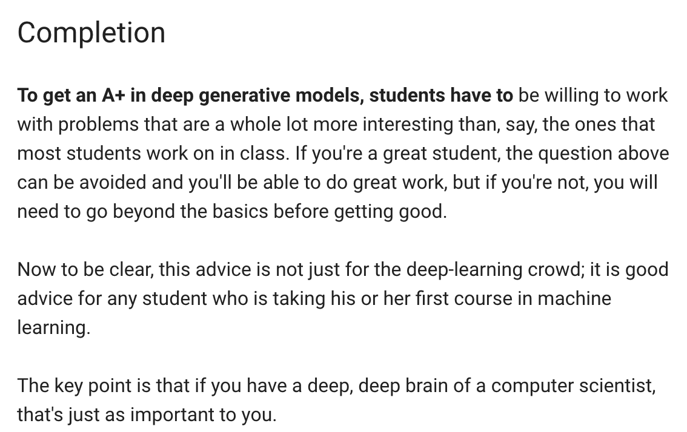
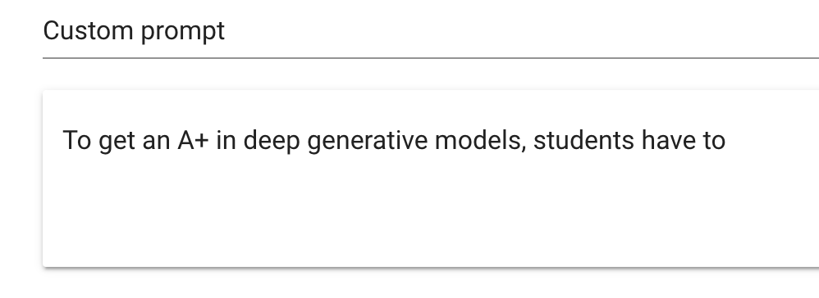
Language Generation
Radford et al., 2019
Demo from talktotransformer.com
P(next word | previous words)

Slide 22
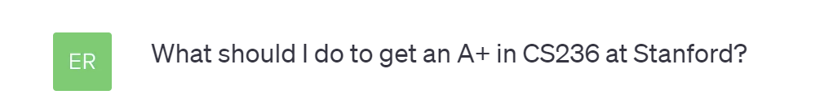
Language Generation -- ChatGPT
To get an A+ in CS236 (Deep Generative Models) at Stanford, you will need to excel in both your understanding of the material and your performance in assignments and exams. Here are some general tips to help you achieve this:
1. **Attend Lectures and Engage Actively**: Attend all lectures and actively engage with the material. Take thorough notes, ask questions, and participate in discussions. This will help you understand the concepts better.
2. **Read the Assigned Material**: Make sure to read the assigned textbooks, papers, and supplementary materials. Understanding the theoretical foundations is crucial.
3. **Stay Organized**: Keep a well-organized notebook or digital notes. This will help you quickly review and understand the material.
4. **Seek Help When Needed**: Don't hesitate to ask questions if you're having trouble with a concept. You can ask the professor, teaching assistants, or classmates for clarification.
5. **Complete Assignments Thoroughly**: Take your time to complete assignments, ensuring you fully understand the requirements and concepts involved. Start early and seek help if you're stuck. High-quality assignments are often a significant portion of your grade.
6. **Collaborate, but Don't Plagiarize**: Collaboration is often encouraged, but make sure you understand your institution's policy on collaboration and plagiarism. Always give credit where it's due and submit original work.
…
15. **Meet with the Professor**: If you're aiming for an A+, consider scheduling meetings with the professor to discuss your progress and seek feedback.
Remember that getting an A+ can be highly competitive, and the specific grading criteria may vary from one course to another and one professor to another. It's essential to understand the grading policies and expectations of your instructor. Always aim for excellence, but also keep in mind that learning and understanding the material should be your primary goal. Good luck!

Slide 23
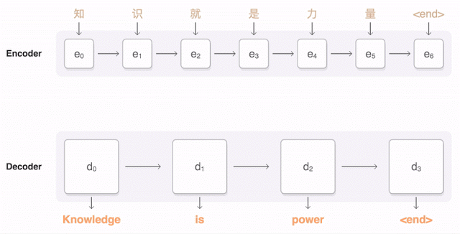
Machine Translation
Conditional generative model P( English text| Chinese text)
Figure from Google AI research blog.

Slide 24
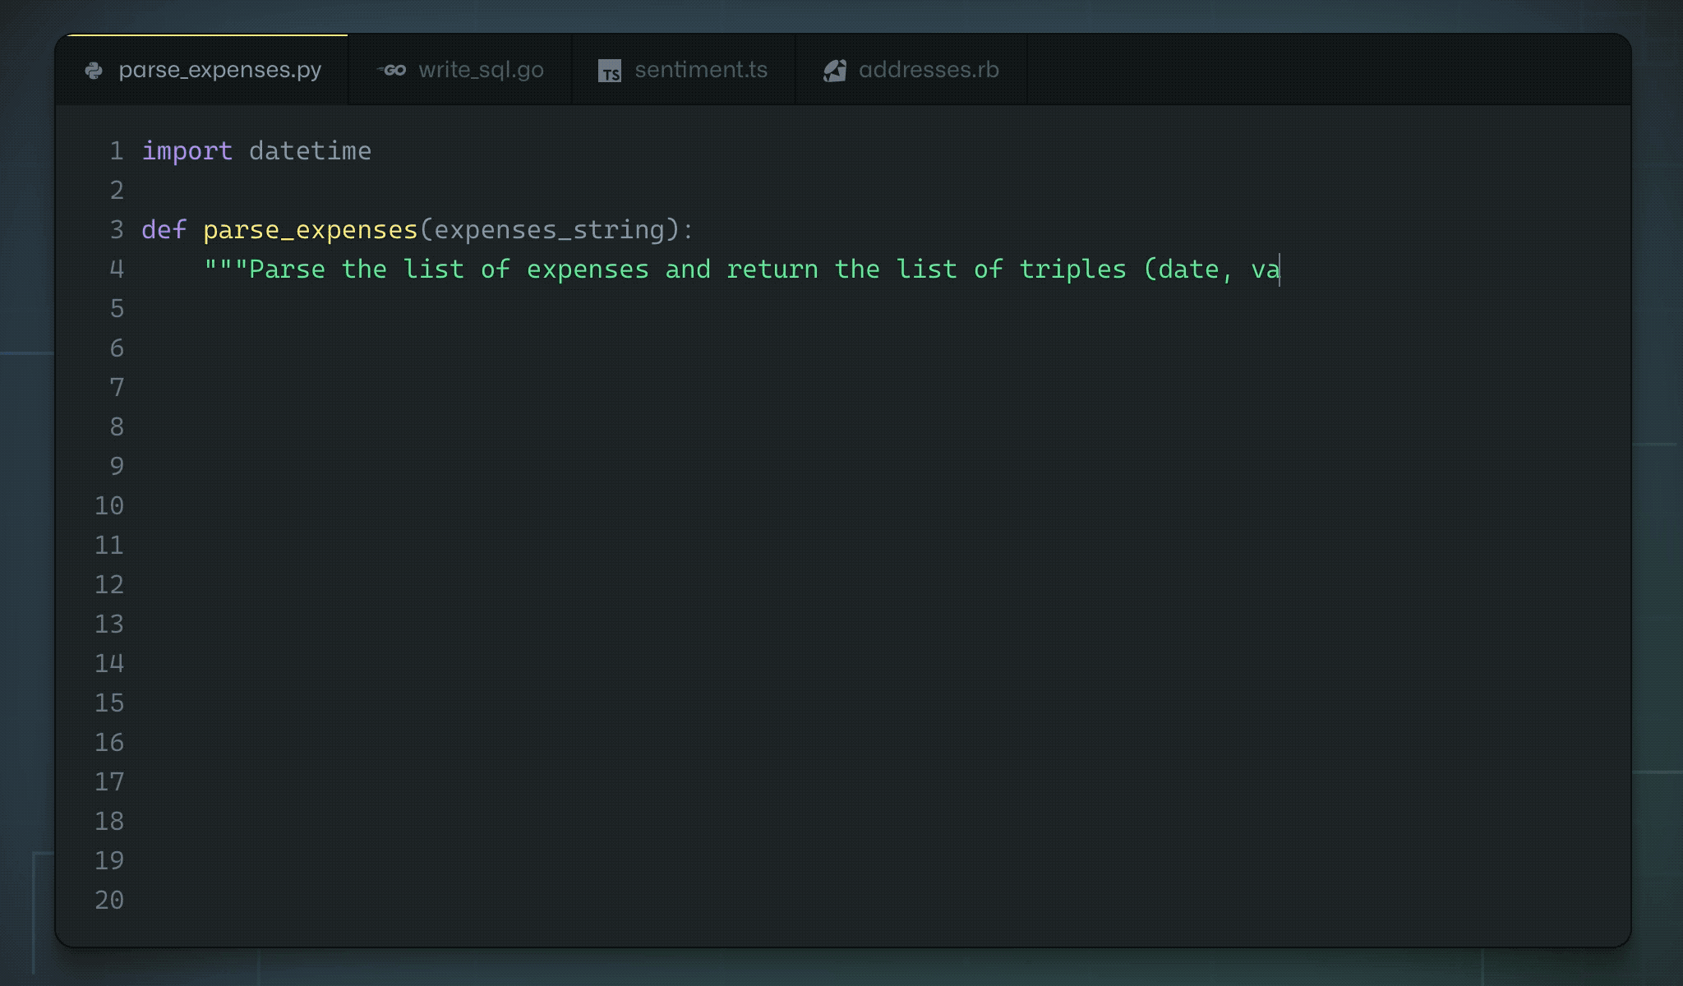
Code Generation
OpenAI Codex

Slide 25
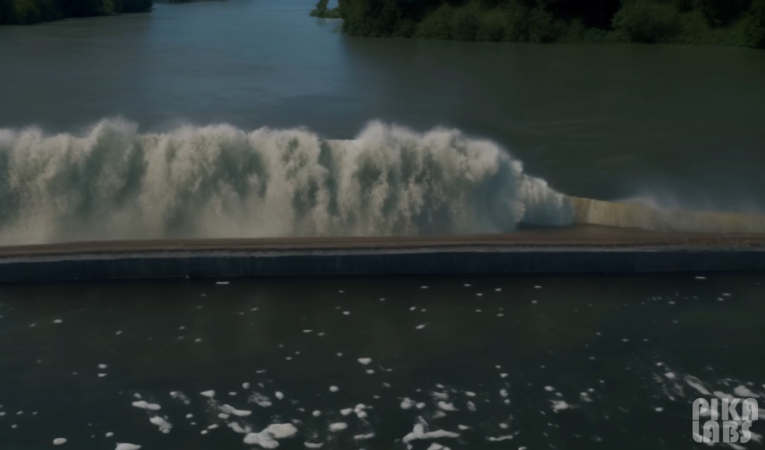
Video Generation
Suddenly, the walls of the embankment broke and there was a huge flood

Slide 26

Video Generation
a couple sledding down a snowy hill on a tire roman chariot style

Slide 27
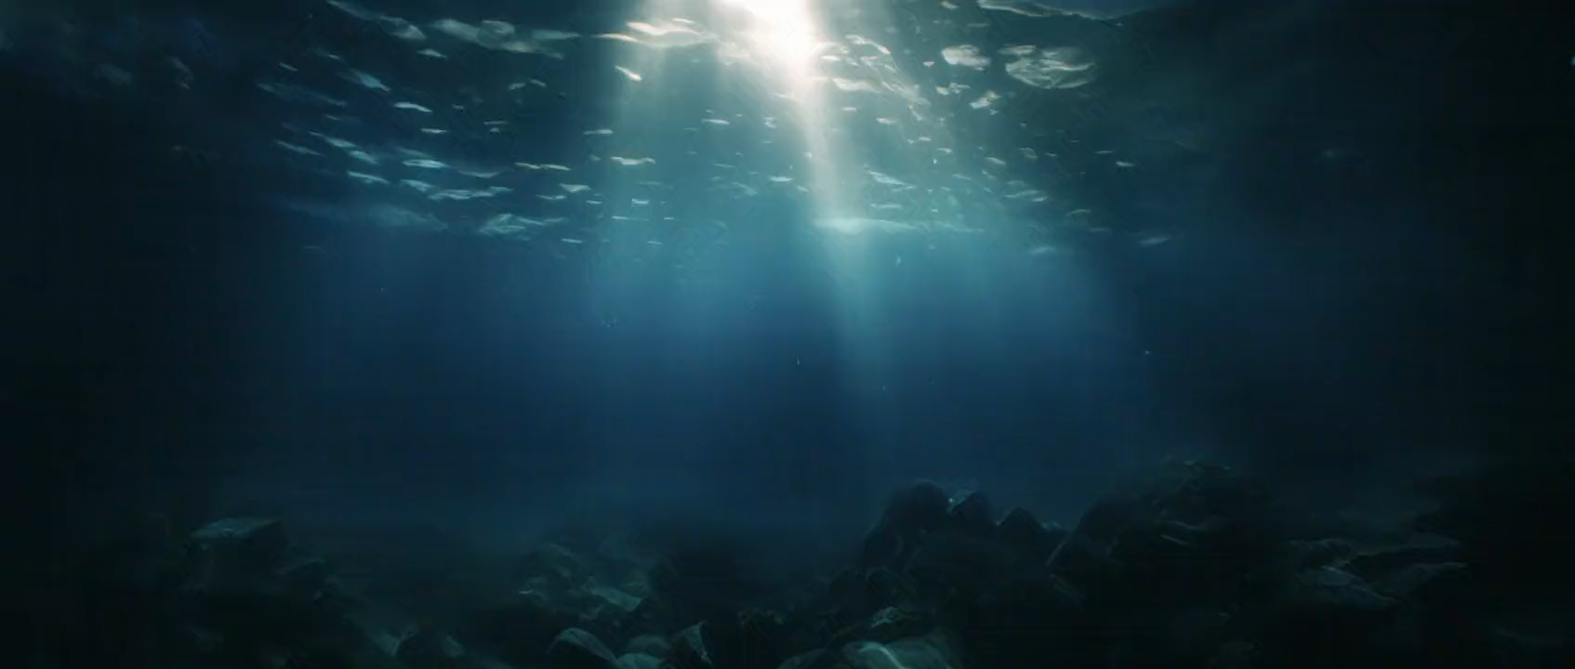
Video Generation

Slide 28
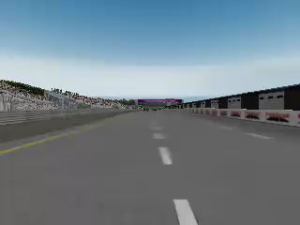
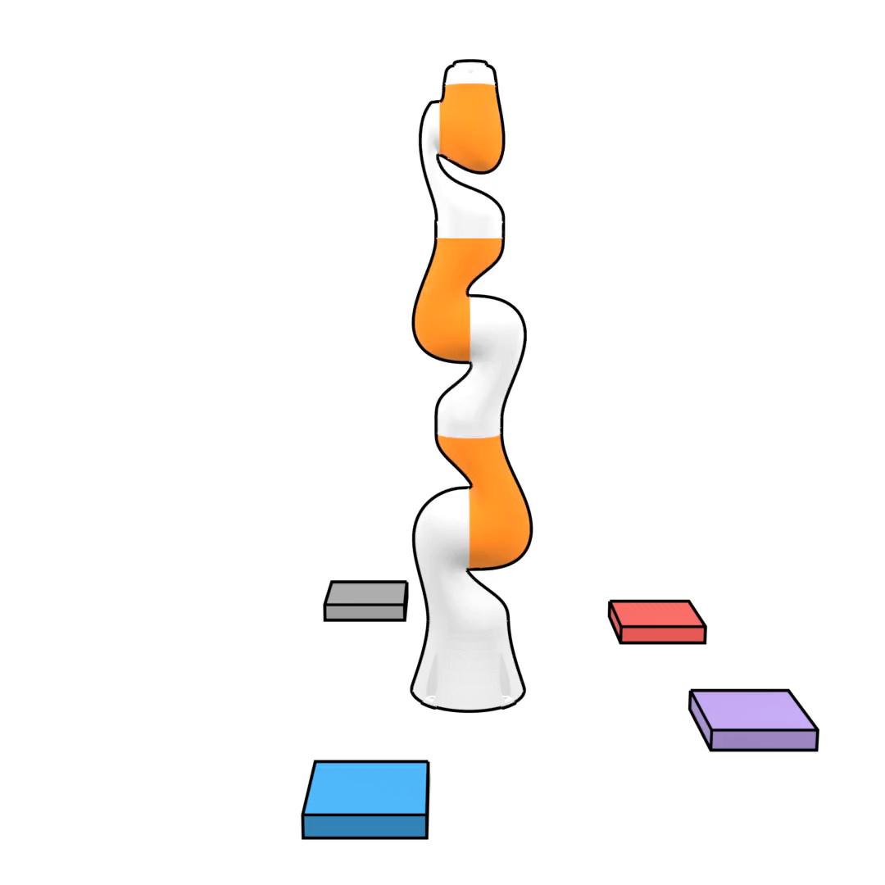
Imitation Learning
Conditional generative model P(actions | past observations)
Li et al., 2017
Janner et al., 2022

Slide 29
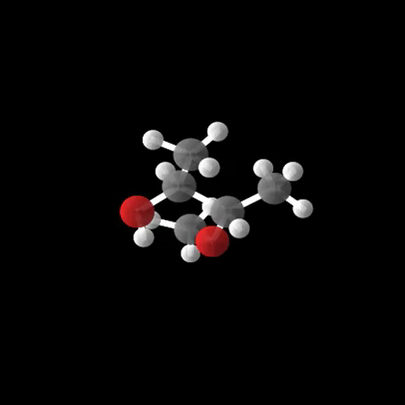
Molecule generation

Slide 30
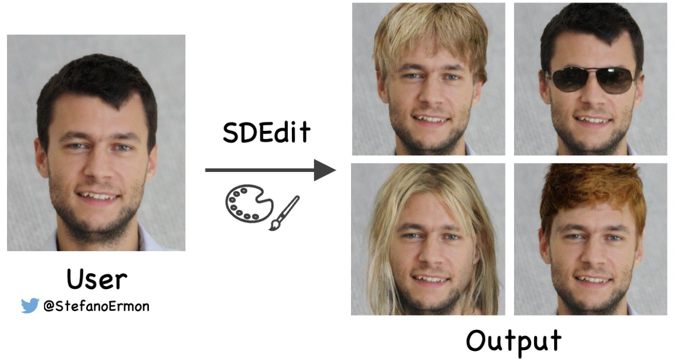
DeepFakes
Which image is real?

Slide 31

DeepFakes

Slide 32
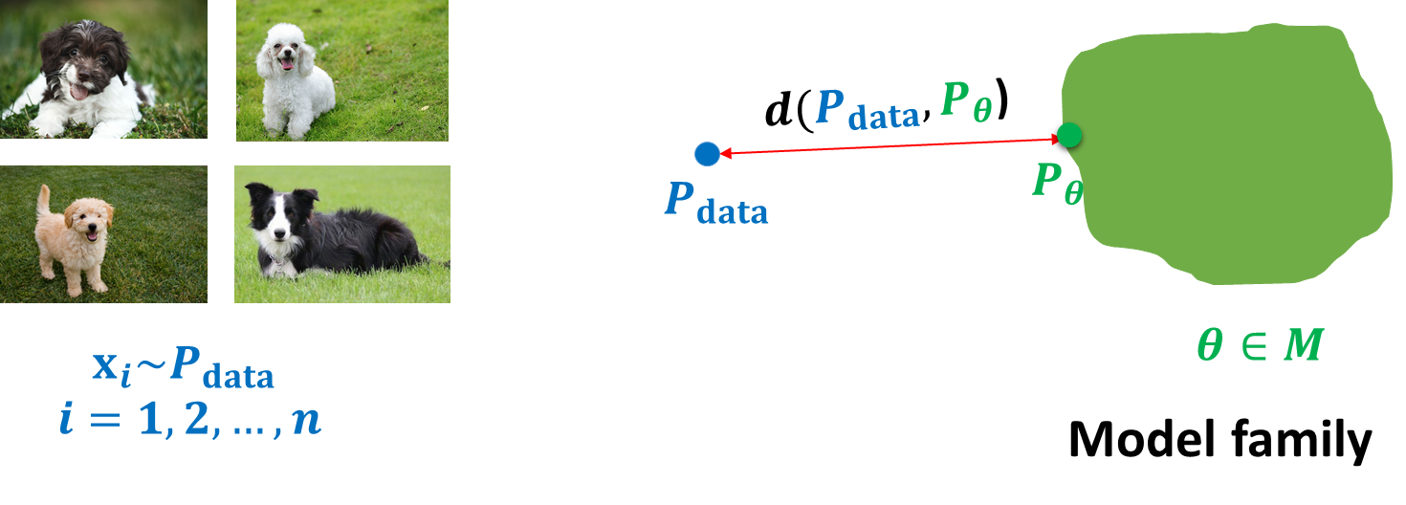
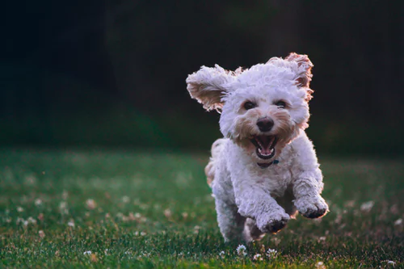
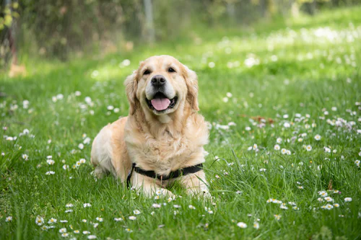
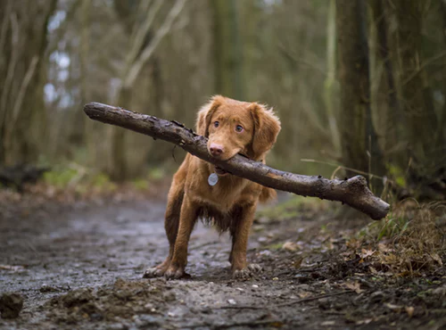
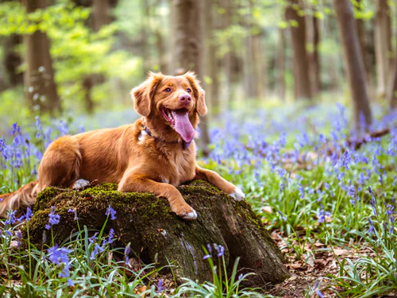
Roadmap and Key Challenges
Representation: how do we model the joint distribution of many random variables?
Need compact representation
Learning: what is the right way to compare probability distributions?
Inference: how do we invert the generation process (e.g., vision as inverse graphics)?
Unsupervised learning: recover high-level descriptions (features) from raw data
Notes:
Dog images from unsplash

Slide 33
Syllabus
Probabilistic Graphical Models
Bayesian Networks
Markov Random Fields
Variational Inference
Deep Generative Models
Variational Autoencoders (VAE)
Flow-based Models
GAN
Diffusion models
Score-based Models
ODE/SDE models
Flow-Matching Models
NLP generative models
Transformers

Slide 34
Prerequisites
Basic knowledge about machine.
Basic knowledge of probabilities and calculus:
Gradients, gradient-descent optimization, backpropagation
Random variables, independence, conditional independence
Bayes rule, chain rule, change of variables formulas
Python programming language

Slide 35
Logistics
Chief TA: Farshad Sangari
TAs:
Amin Mousavi
Fatemeh TaheriNejad
Nasrin Amjadi
Fatemeh Nadi
Erfan Asgari
Maryam Dadkhah
Yasaman Haghbin

Slide 36
Grading
4 Homework Assignments:
8 points
Grace: 12 days
Midterm Exam:
21st Aban
6 points
Final Exam:
3rd Bahman
6 points

